Slide 1
Grocery Store Automatic Product Detection
By
Onur Can
Supervised by Assist. Prof. Dr. Dionysis Goularas

Slide 2
Outline
INTRODUCTION 03
RELATED WORK 05
ANALYSIS & DESIGN 09
IMPLEMENTATION 17
TEST & RESULTS 20
CONCLUSION & FUTURE WORK 26

Slide 3
INTRODUCTION

Slide 4
Motivation
Managing grocery products at shelves is costs money, time and human labor.
As a solution automatic product detection system can reduces amount of spending money, time and human labor.
Tried to achieve more than 75% accuracy and 75% precision rate in detection of products.

Slide 5
RELATED WORK

Slide 6
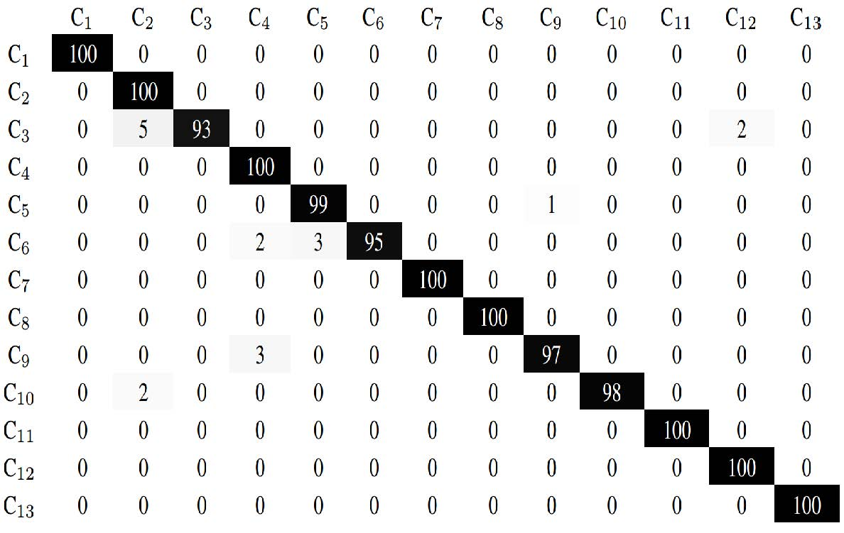
Planogram Matching Control in Grocery Products by Image Processing
99.03% precision in detection of shelf lines
97.31% precision in recognition of products
99.21% accuracy in identification of brands

Slide 7
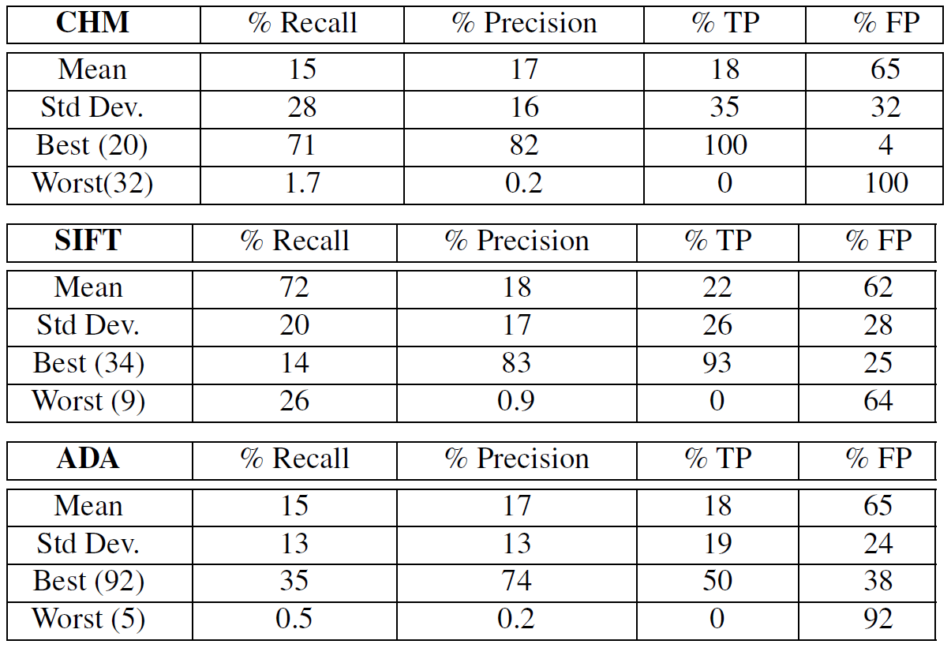
Recognizing Groceries in situ Using in vitro Training Data
Using GroZi-120 as dataset
Two different recording of images as ideal and noisy
Using object detection algorithms as SIFT matching, color histogram matching, boosted Haar-like features

Slide 8
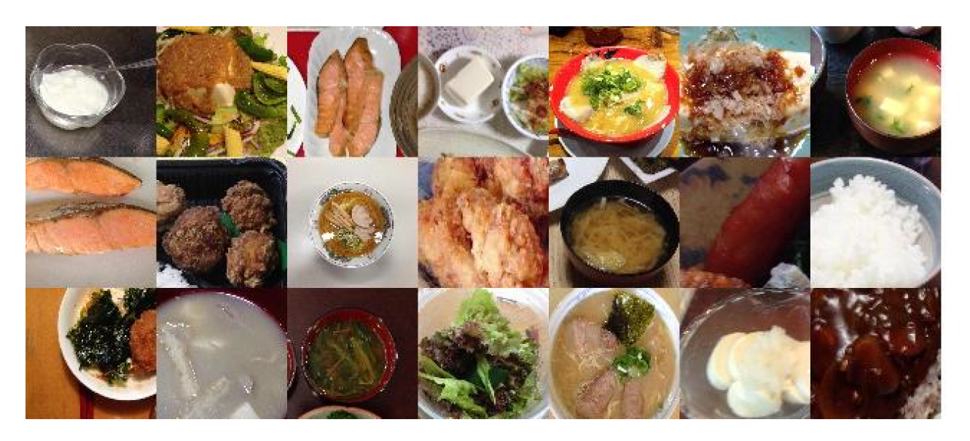
Food Detection and Recognition Using Convolutional Neural Network
Generated their own dataset
Used convolutional neural networks
Their convolutional neural network shows better accuracy than traditional support vector machine based techniques did

Slide 9
ANALYSIS & DESIGN

Slide 10
Dataset Generation
Mopaş | Şok | Hakmar | A101
1709 | 838 | 472 | 968
Cereals | 215 | Juice | 160 | Soap | 157
Chips | 225 | Ketchup | 78 | Sugar | 85
Chocolate | 352 | Milk | 273 | Tea | 286
Coffee | 210 | Oil | 148 | Toilet paper | 105
Deodorant | 105 | Olive | 164 | Tomato sauce | 100
Detergent | 346 | Pasta | 177 | Toothbrush | 56
Flour | 106 | Salt | 101 | Vinegar | 70
Honey | 85 | Shampoo | 225 | Water | 158

Slide 11
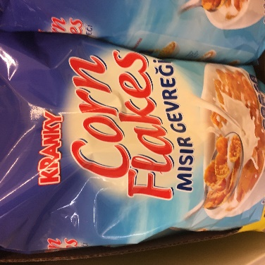
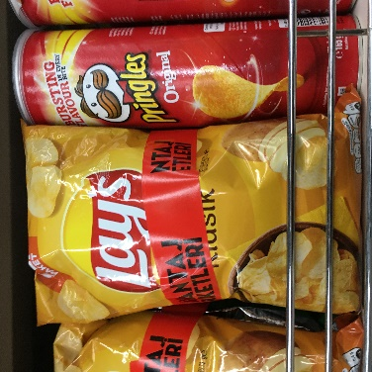
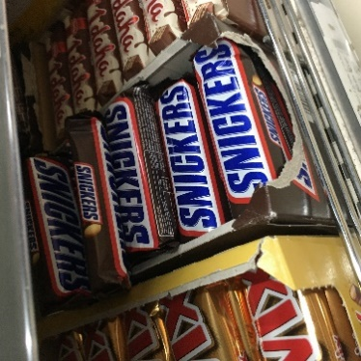
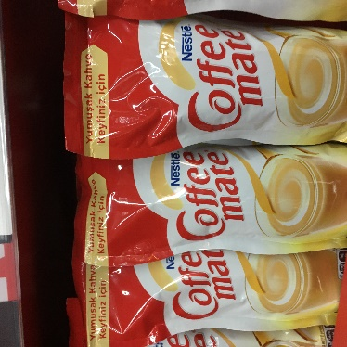
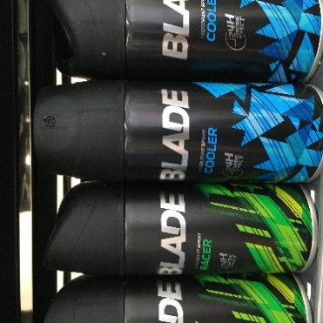
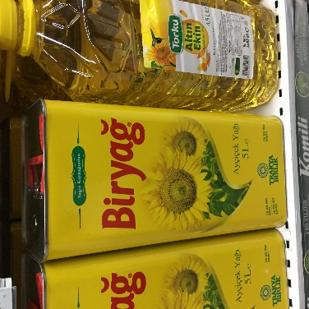
Some Examples of Products in the Dataset

Slide 12
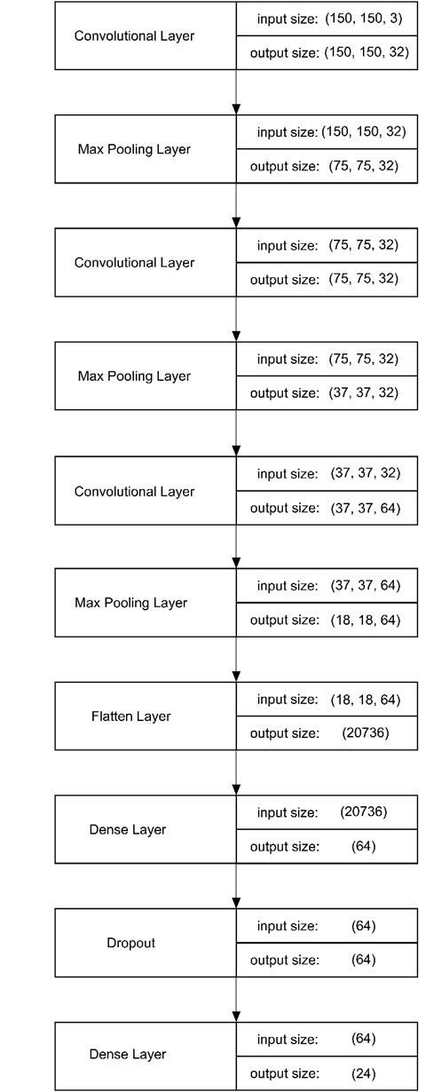
My CNN Model
Input shape: 150x150 pixels
9 Layers in total (3 convolutional + 2 pooling + 1 flatten + 2 dense)
5 Weight layers (3 convolutional + 2 dense)
30% Dropout to prevent overfitting

Slide 13
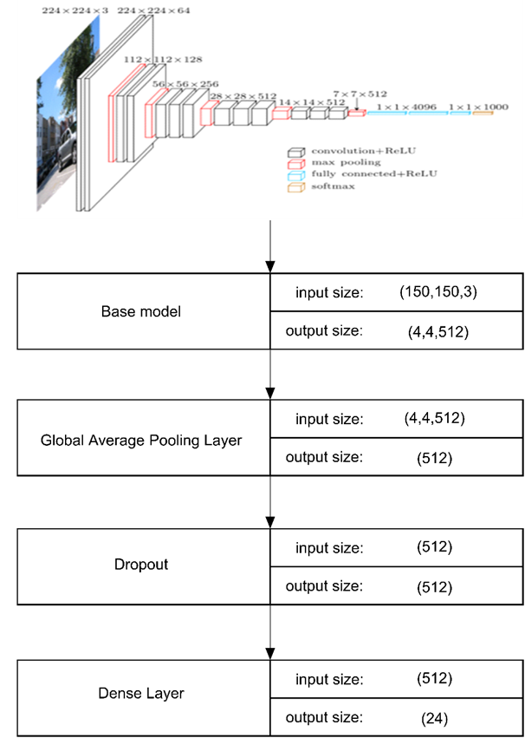
VGG16 Model
Original input shape: 224x224 pixels
Resized input shape: 150x150 pixels
Originally 16 weight layers (13 convolutional + 3 dense)
30% Dropout to prevent overfitting

Slide 14
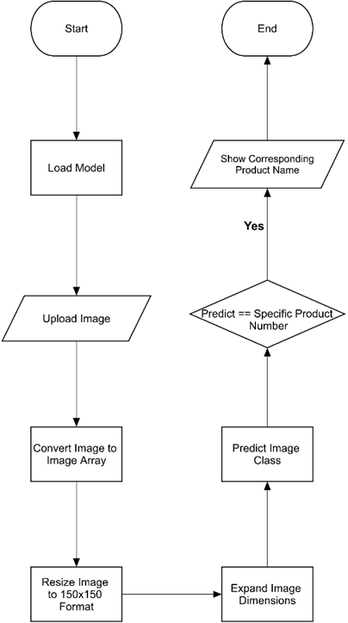
Grocery Products Prediction Mechanism

Slide 15
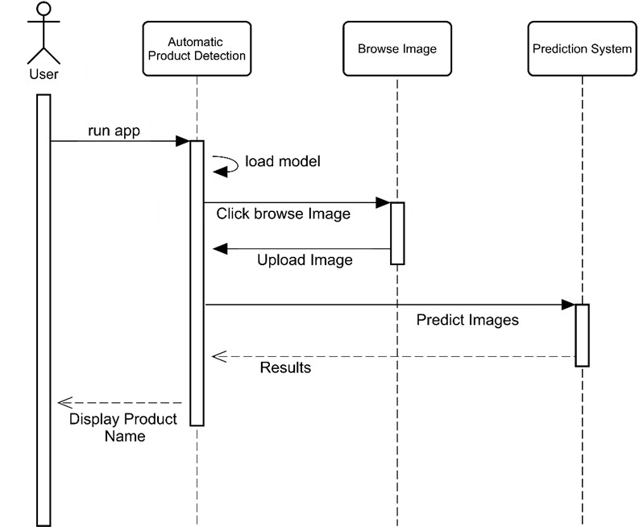
Web Application System

Slide 16
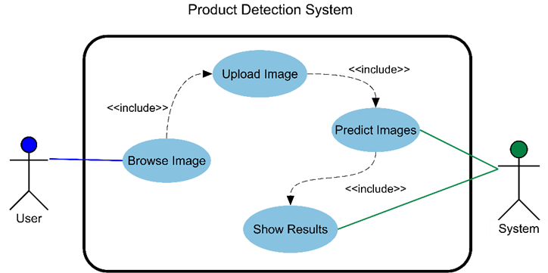
Application Working Schema

Slide 17
IMPLEMENTATION

Slide 18
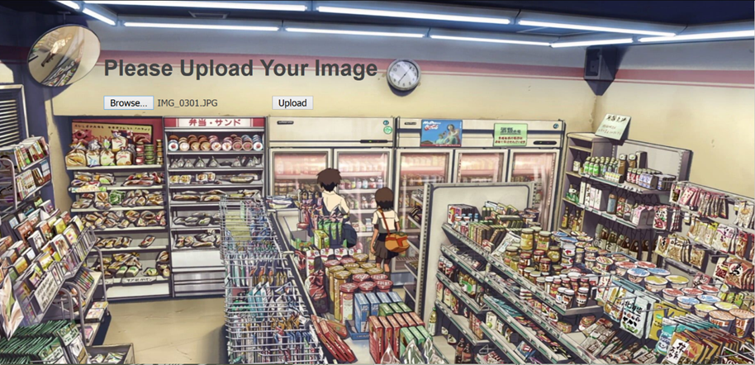
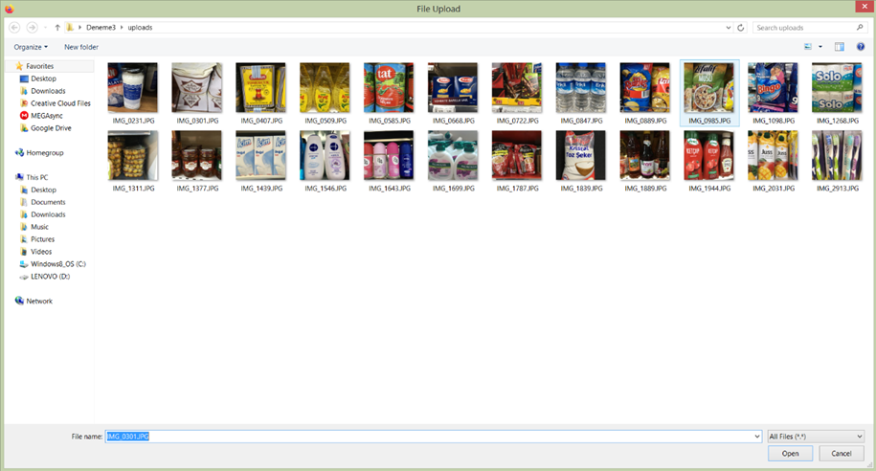
Web Application

Slide 19
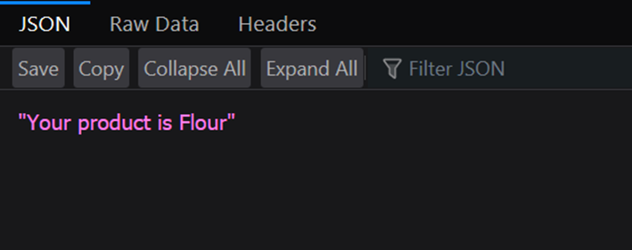
Sample Result Page

Slide 20
TEST & RESULTS

Slide 21
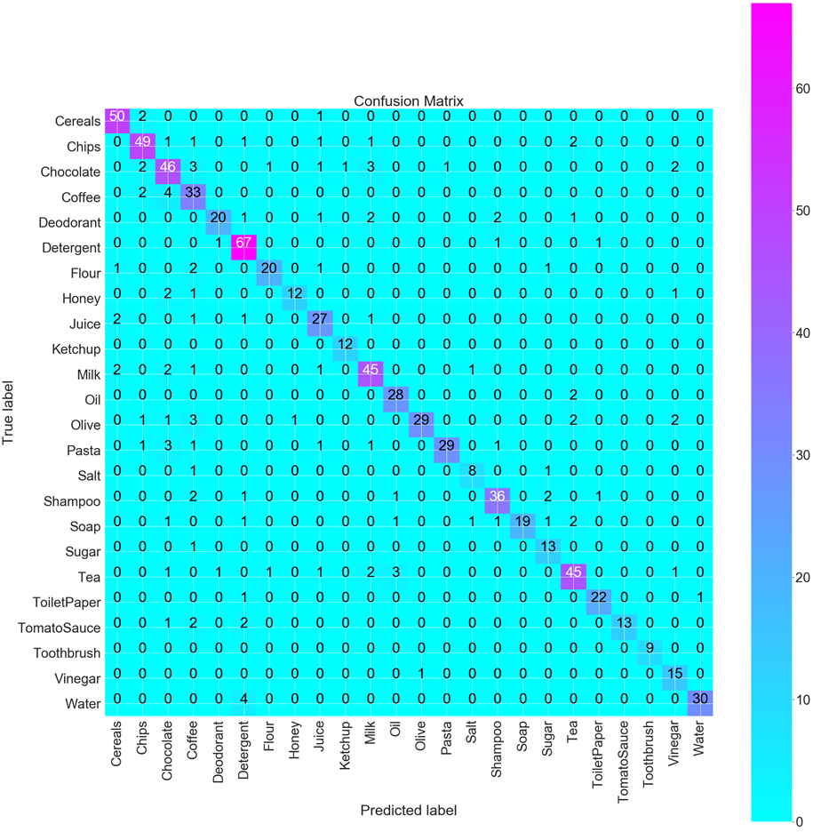
Analysis of CNN Grocery Product Detection Model
Precision | Recall | F1-Score | Accuracy
0.87 | 0.85 | 0.85 | 0.85

Slide 22

Analysis of VGG16 Grocery Product Detection Model
Precision | Recall | F1-Score | Accuracy
0.85 | 0.82 | 0.83 | 0.81

Slide 23
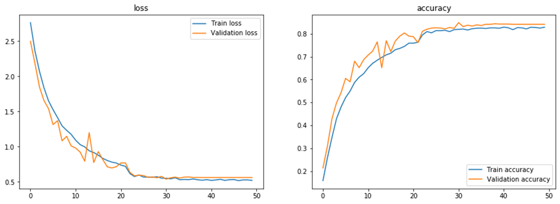
Training History Results of CNN Model

Slide 24
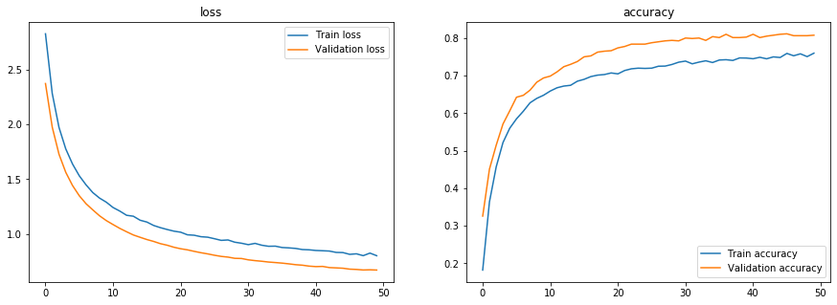
Training History Results of VGG16 Model

Slide 25
Comparison With Related Works
Name of Study | Dataset Name | Classification Method of Study | Accuracy of Study’s Model | Accuracy of My CNN Model | Accuracy of My VGG16 Model
Classifying food items by image using Convolutional Neural Networks | Freiburg groceries dataset | Alexnet | 73.2%. | 44.1% | 57.67%
Classifying food items by image using Convolutional Neural Networks | Freiburg groceries dataset | GoogleNet | 75.64% | 44.1% | 57.67%
Classifying food items by image using Convolutional Neural Networks | Freiburg groceries dataset | CaffeNet | 77.03% | 44.1% | 57.67%
A deep learning pipeline for product recognition on store shelves | GroZi-120 | CNN and KNN | 32.5% | 73.5% | 86.0%
Toward retail product recognition on grocery shelves | Their own dataset | SIFT and HSV | 92.3% | 99.87% | 100%
Product placement detection based on image processing | Their own dataset | HOG and OpenCV | 96 % | 99.87% | 100%

Slide 26
CONCLUSION & FUTURE WORK

Slide 27
Conclusion & Future Work
Conclusion:
My custom CNN model shows better performance than VGG16 did
Comparison with Related Works shows that performance depends on dataset features.
As future work:
Adding detection of multiple products from one picture
Identifying which shelf contains which product
Counting how many products left on shelf

Slide 28
Thank You For Listening
Do you have any questions?

